Slide 1
Problem Statement
Team: Divyansh Dubey (12340690) · Keshav Mishra (12341140) · Lakshay Gupta (12341300)
Novelty ECERC Revisited: Mitigating Category Confusion, Class Imbalance and Cause-Gating Miscalibration in Evidence-Cause Attention Networks for Multi-Modal Emotion Recognition in Conversation
ECERC explains each emotion through four cause types (self/cross-party events and emotions). Keeping its causal backbone fixed, we attach one targeted, separately ablated fix to each failure mode it leaves open: confusable emotions, rare emotions, and an uncalibrated way of weighing causes. The key new component turns cause weighting into an explicit, context-aware and availability-masked distribution over the four cause types, and we evaluate it for calibration (ECE), not only accuracy.
Contributions all three: joint reproduction of ECERC on IEMOCAP and MELD
Divyansh Dubey
Category Confusion · IEMOCAP
Confusion-aware supervised contrastive loss on fused features
Pair-confusion penalty for Happy↔Excited and Angry↔Frustrated
P4 vs authors: pair errors 180.5 → 174.3 (Hap↔Exc 87.0 → 79.0)
Keshav Mishra
Class Imbalance · MELD
Class-balanced (effective-number) weights and focal loss γ = 2
Dialogue-level oversampling of Fear and Disgust
Controlled 3-seed study, validation-only model selection
Lakshay Gupta
Cause-Gating Calibration · both
CACG: masked cause-level softmax with a per-utterance temperature
Label-grounded utility gate loss; fixed empty-history attention leak
ECE 13.6 → 2.9 (IEMOCAP), 9.5 → 2.4 (MELD)

Slide 2
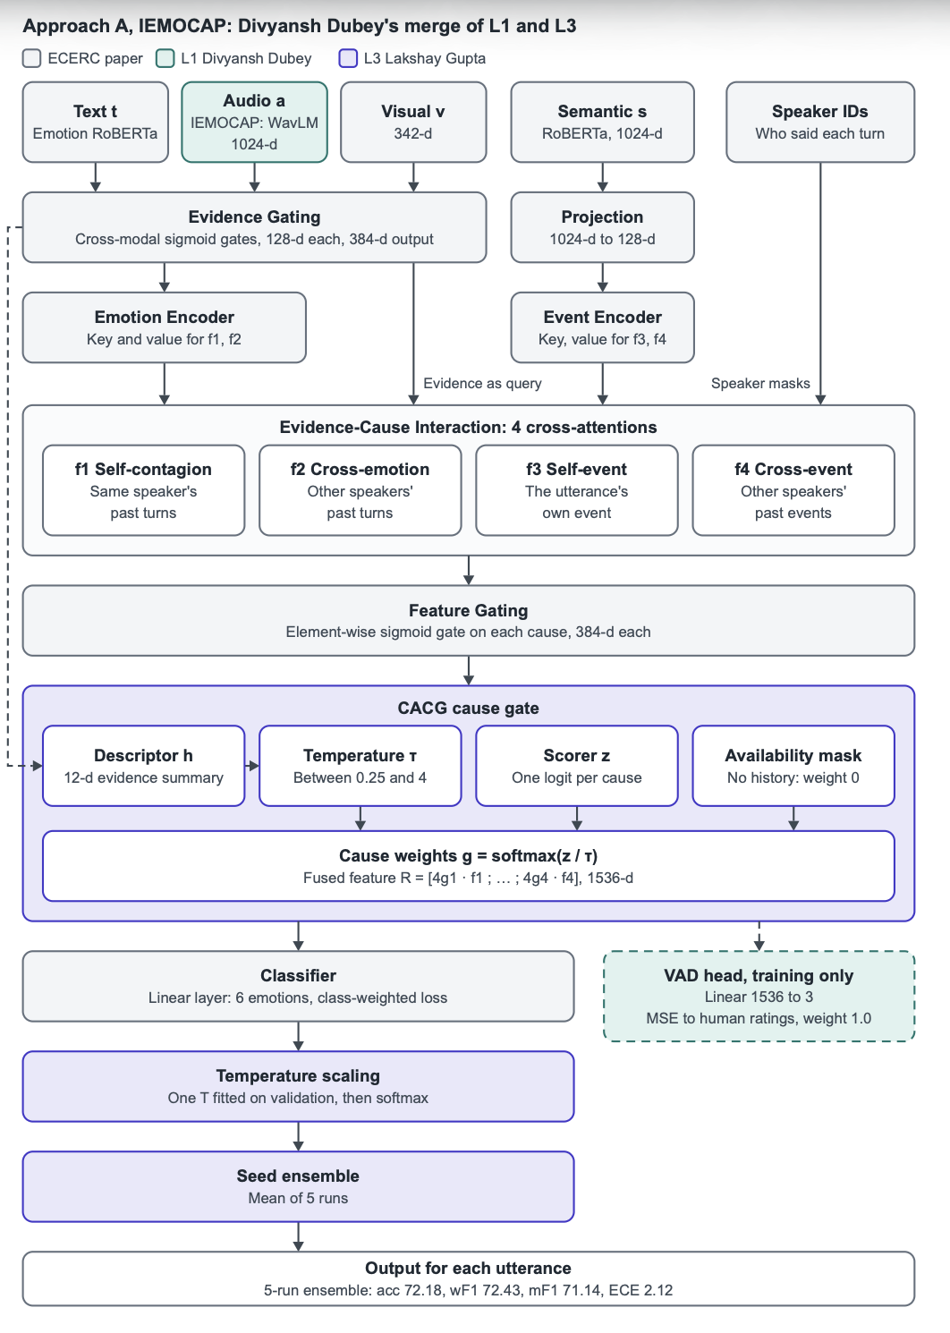
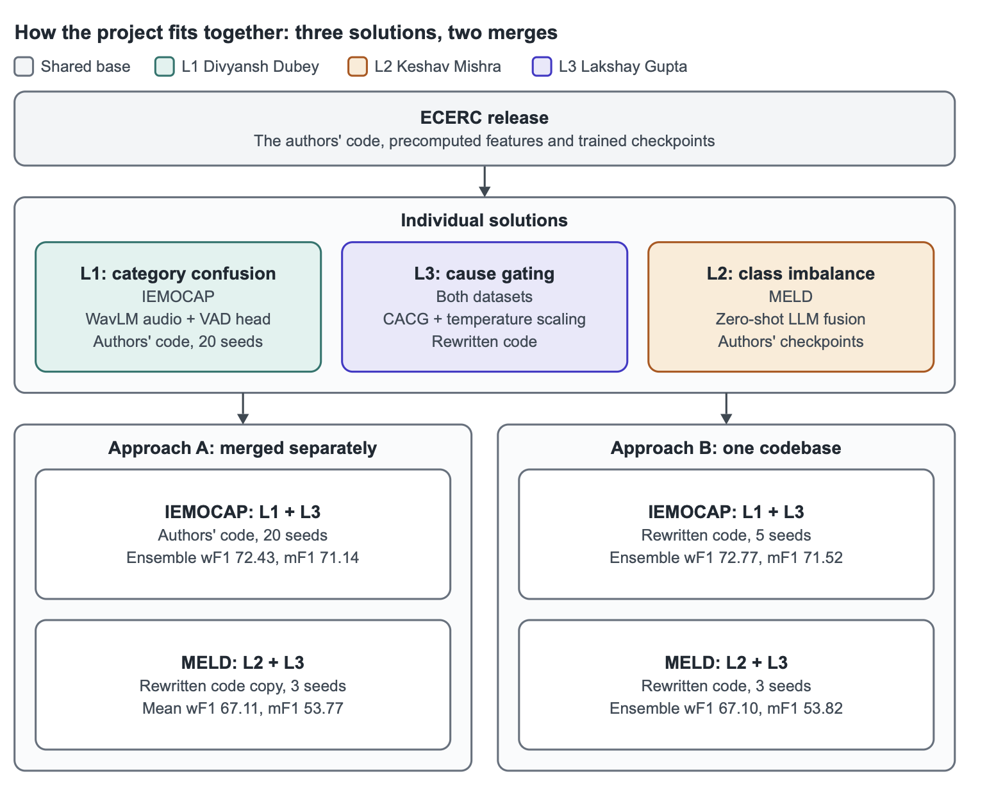

Slide 3
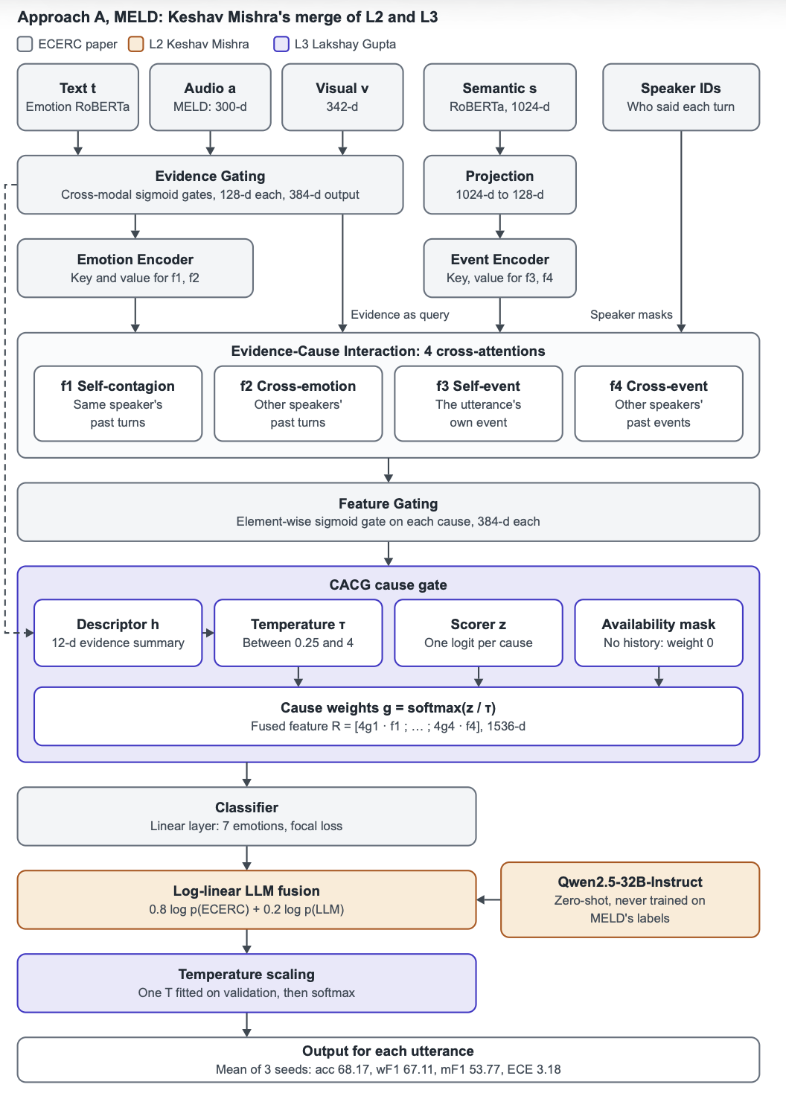
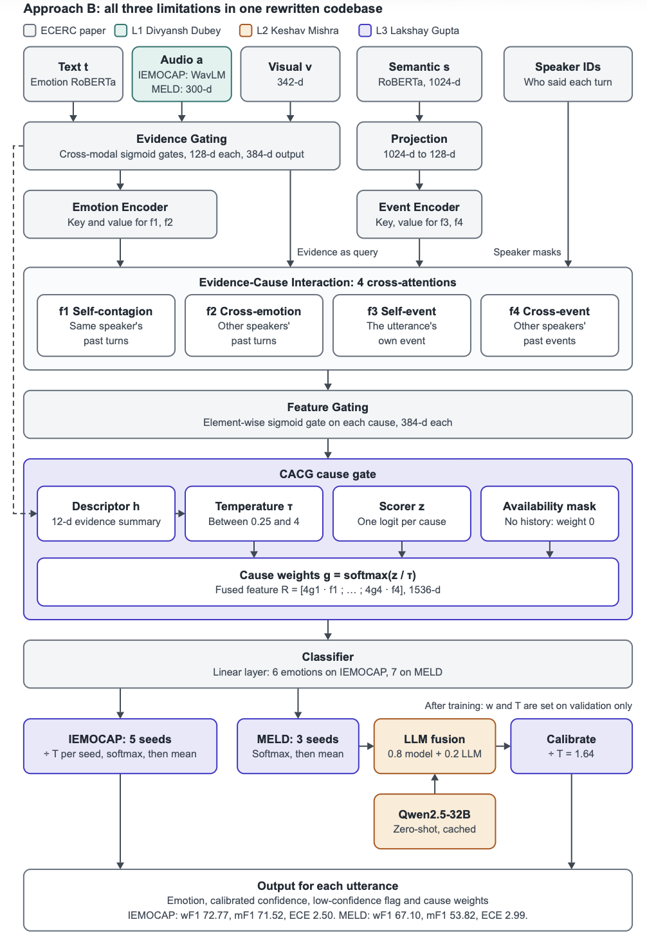

Slide 4
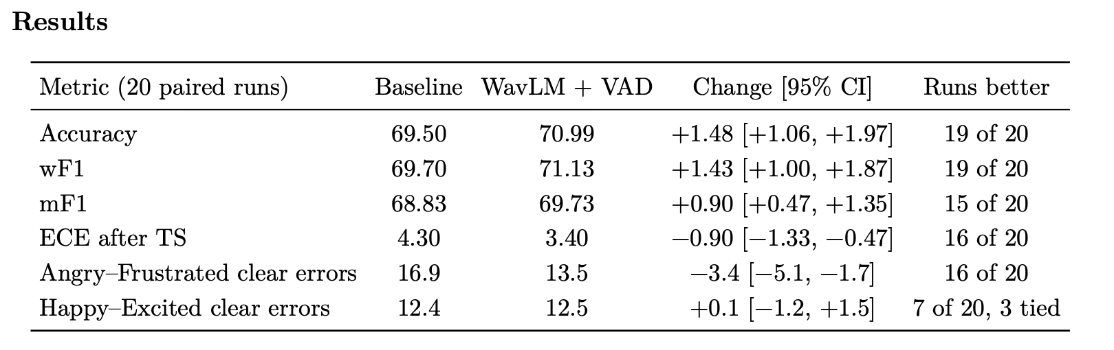

Slide 5
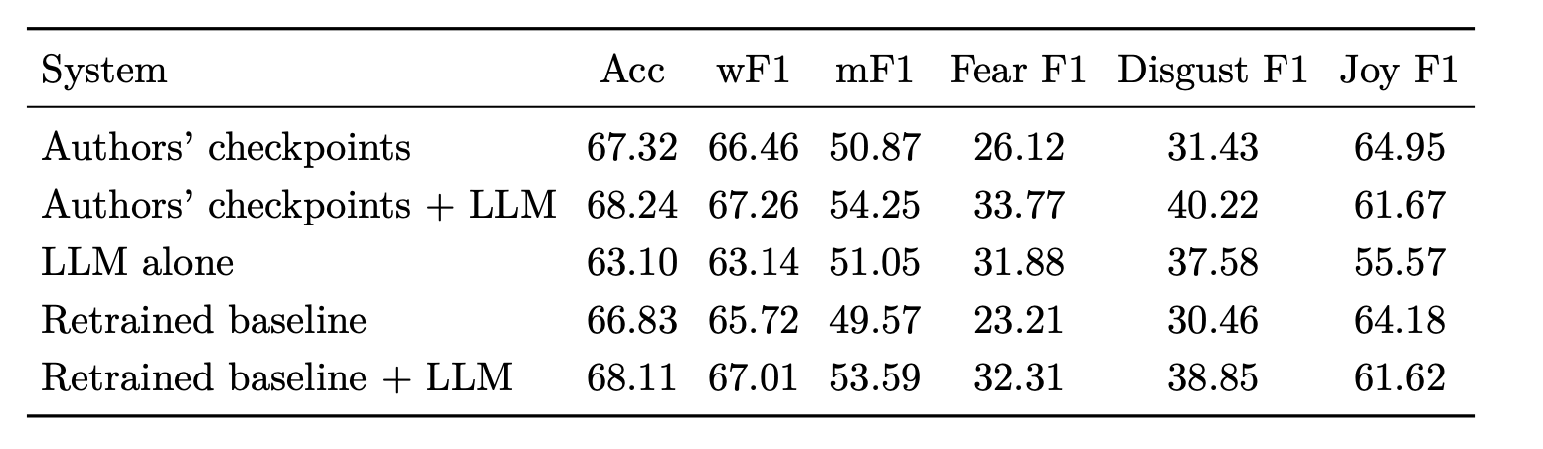

Slide 6
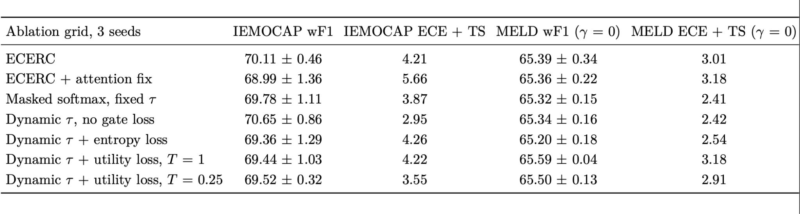

Slide 7
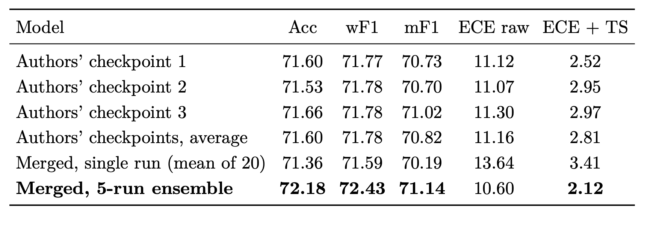
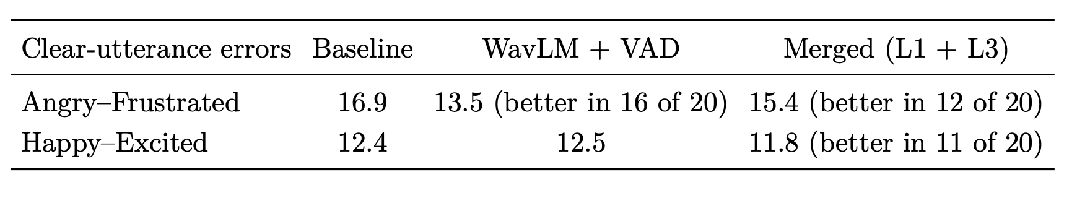

Slide 8
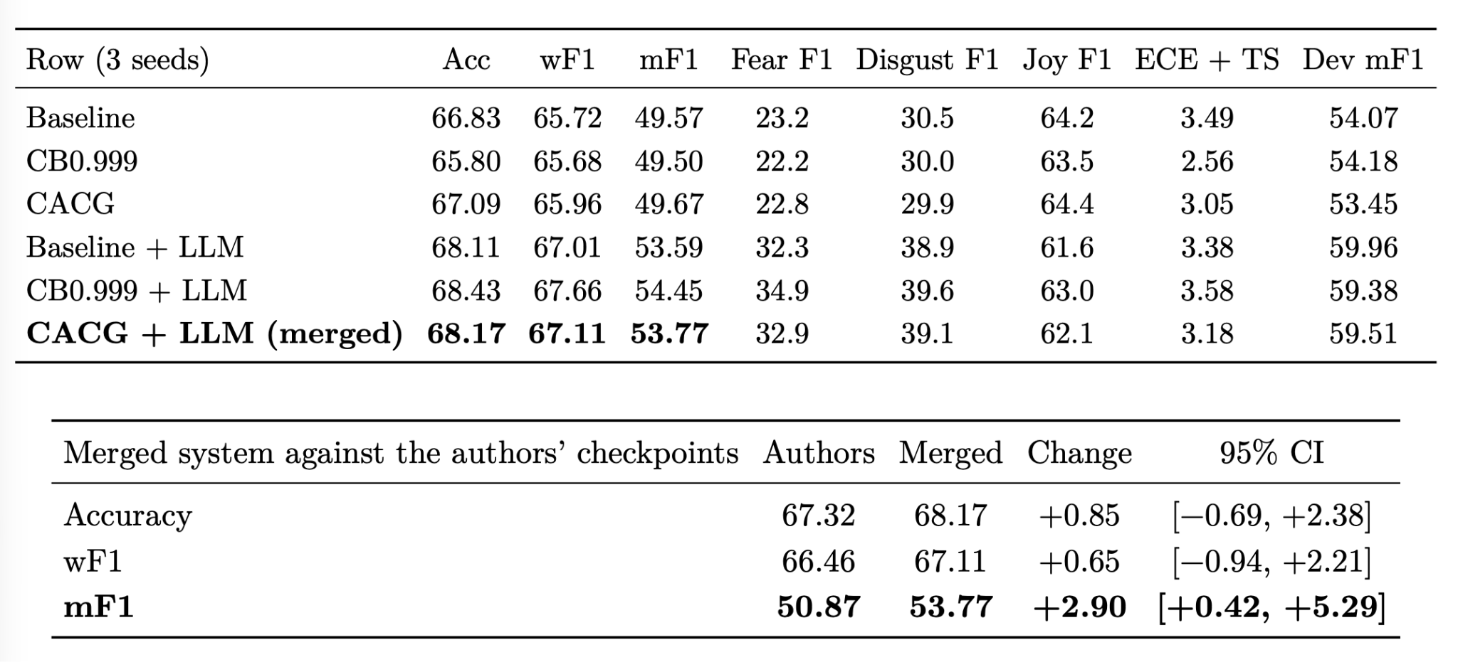

Slide 9
